Slide 1
DO, eQTL, and capeDO

Slide 2
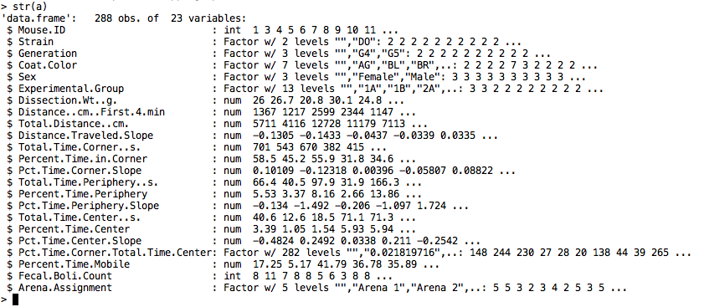
Data
258 DO mice (M/F: 132/126) with genotype, hippocampus gene expression, and behaviors

Slide 3
QTL mapping pipeline
258 DO mice
MUGA
7802 markers with effective founder haplotype probabilities
7664 markers with effective allele calls
RNA-seq
Total of 16876 genes with effective expression values
Quantile normalization over samples
Z-transformation over genes
eQTL: DOQTL (Random effect model with kinship correction)
Permutation in DO
Permute phenotype and covariates together
Keep genotype intact, no kinship correction
Take the maximum for each permutation (M: m1, m2, …)
Choose the 0.95 quantile of M

Slide 4
DOQTL: LOD distribution
7.31

Slide 5
DOQTL: summary statistics
Number of SNPs | 7,312
Number of genes | 16,876
SNP-gene pairs tested | 123,397,312
Significant SNP-gene pairs | 492,285 (0.40%)
Unique significant SNPs | 7,312
Unique significant eQTL-lined genes | 10417
cis only SNPs | 1100
trans only SNPs | 0
cis & trans SNPs | 6212
cis & trans-linked genes | 10296

Slide 6
eQTL map

Slide 7
NEXT
Detect allelic interaction with CapeDO
Detect trans conditioned on cis

Slide 8
Period

Slide 9
QTL mapping pipeline

Slide 10
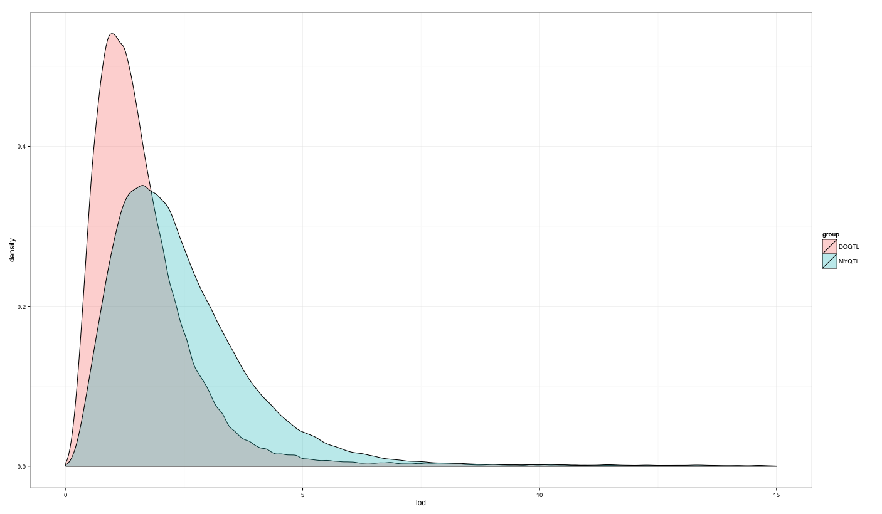
Method 1 and 2: Cis/Trans

Slide 11
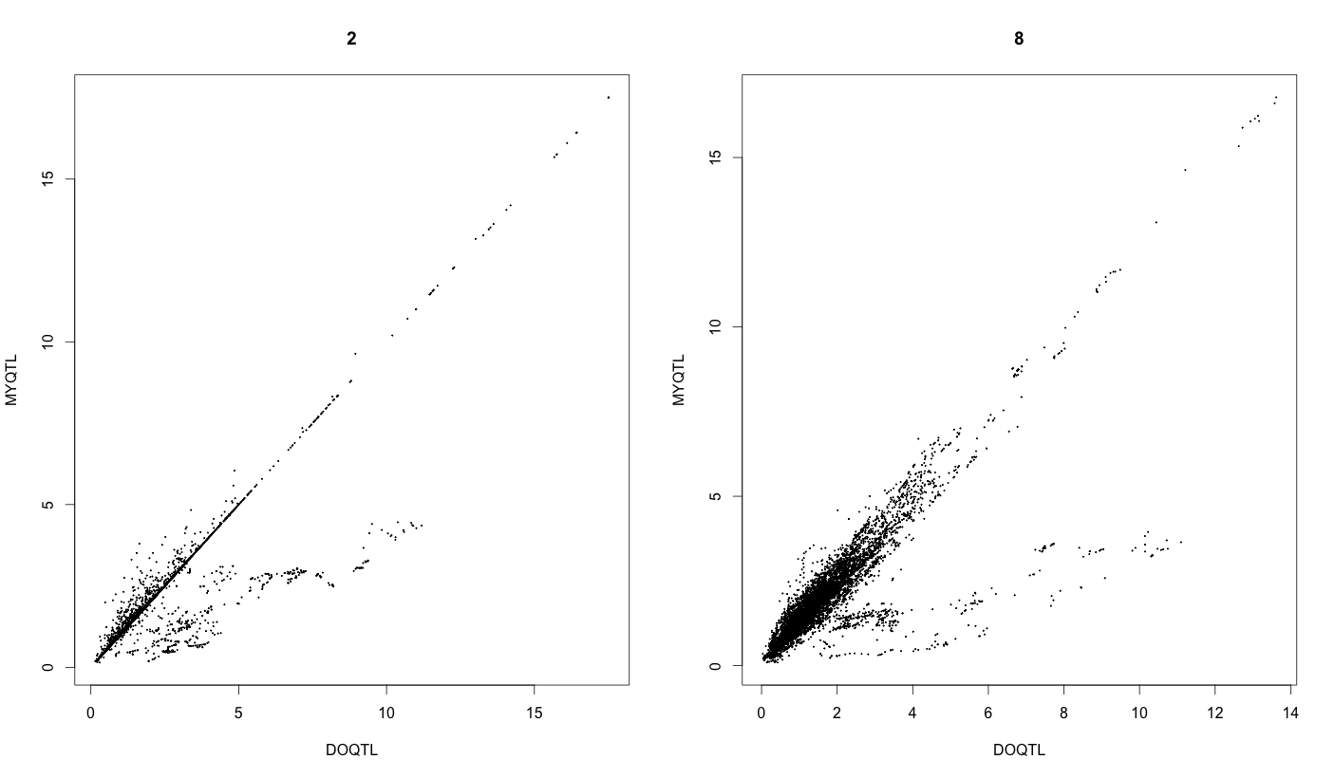
Method 1 and 2: Cis/Trans

Slide 12
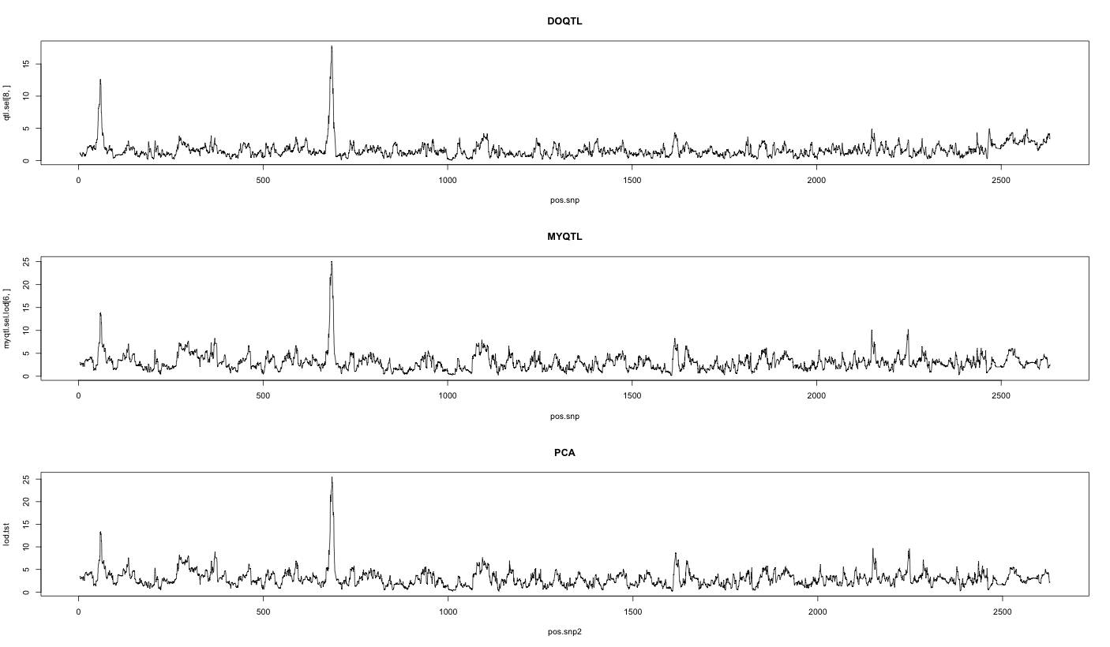
Method 1, 2 and 3 comparison

Slide 13
Trans-eQTL
5’
SNP A/G
3’
Gene X
Promoter
Exon 1
Intron 1
Exon 2
Protein X
5’
3’
Gene Y
Promoter
Exon 1
Intron 1
Exon 2

